Slide 1
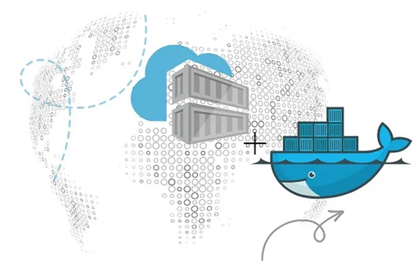
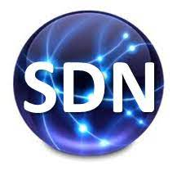
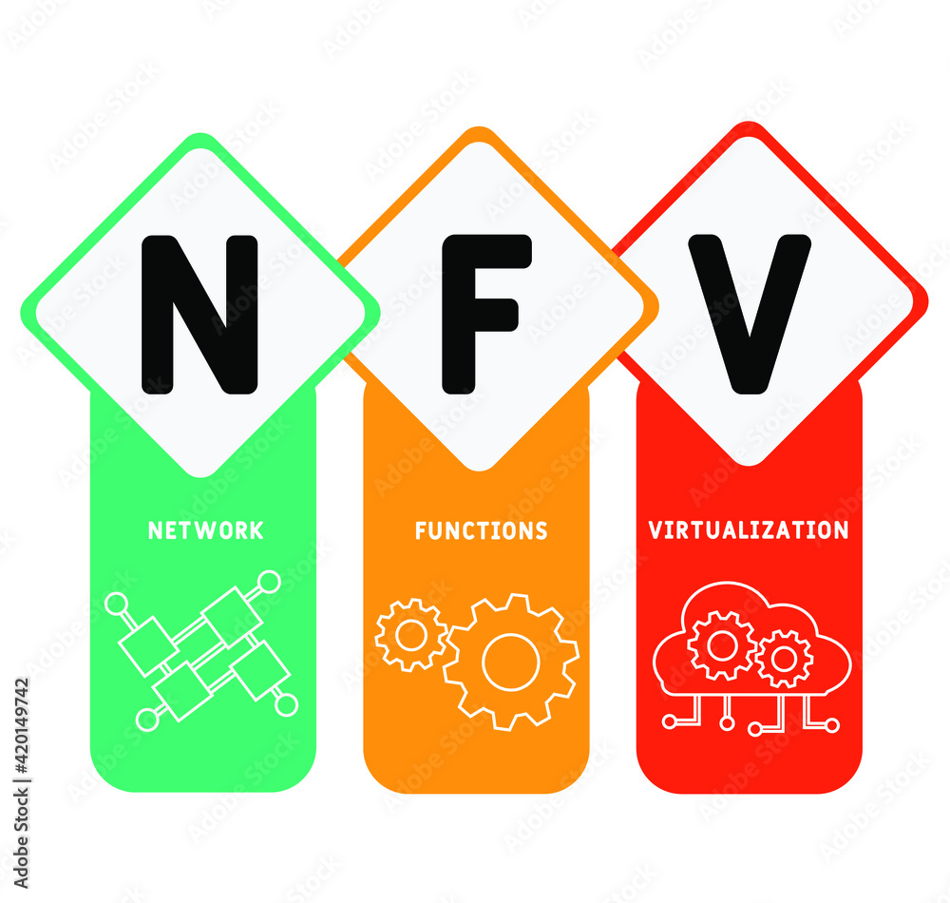
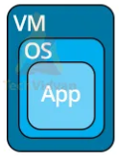
PDS
Computer Vision
Chapter 5-1:
Artificial Neural Network
https://github.com/siagianp
https://github.com/amelcharolinesgn2/IoT_simulator-mqtt-NodeRed
https://www.youtube.com/@AmelOline/videos

Slide 2
Input
Conv2d
ReLU
ReLU
ReLU
ReLU
Dropout
Dropout
Conv2d
Dropout
Conv2d
ReLU
Conv2d
Conv2d
ReLU
ReLU
ReLU
Dropout
Dropout
Dropout
Conv2d
Dropout
Conv2d
Conv2d
Conv2d
+
+
+
+
ReLU
ReLU
MaxPooling2D
Dropout
MaxPooling2D
Dropout
Conv2d
Conv2d
ReLU
ReLU
ReLU
Dropout
Flatten
Dropout
Dropout
ReLU
Conv2d
Conv2d
Dense
Conv2d
Dropout
+
+
Sigmoid
Predictions

Slide 3
Thank you!
PDS
SDN
NFV
Computer Vision
Thank you For being a great class!
https://github.com/siagianp
https://github.com/amelcharolinesgn2/IoT_simulator-mqtt-NodeRed
https://www.youtube.com/@AmelOline/videos
Notes:
https://medium.com/buildpiper/simplifying-containerization-with-docker-run-command-2f74e114f42a
https://github.com/IBA-Group-IT/IoT-data-simulator
https://www.bevywise.com/blog/docker-mqtt-broker-easy-service-manageability/

